Slide 1
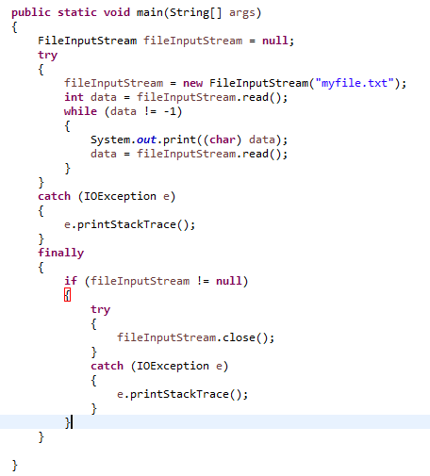
Try-with-resources
Resource Management With try-catch-finally
Managing resources that need to be explicitly closed is somewhat tedious before Java 7.

Slide 2
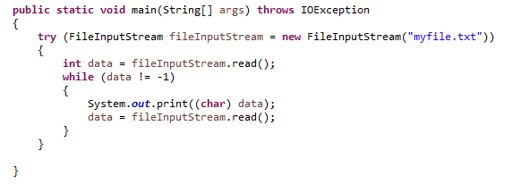
Try-with-resources
In Java 7 we can write the code the
try-with-resource construct like this.
The FileInputStream variable is declared inside the parentheses after the try keyword. Additionally, a FileInputStream is instantiated and assigned to the variable.
When the try block finishes the FileInputStream will be closed automatically. This is possible because FileInputStream implements the Java interface java.lang.AutoCloseable. All classes implementing this interface can be used inside the try-with-resources construct.
FileInputStream will be closed regardless of whether the try statement completes normally or abruptly (as a result of the method fileInputStream.read() throwing an IOException).
Resource Management With try-with-resource

Slide 3
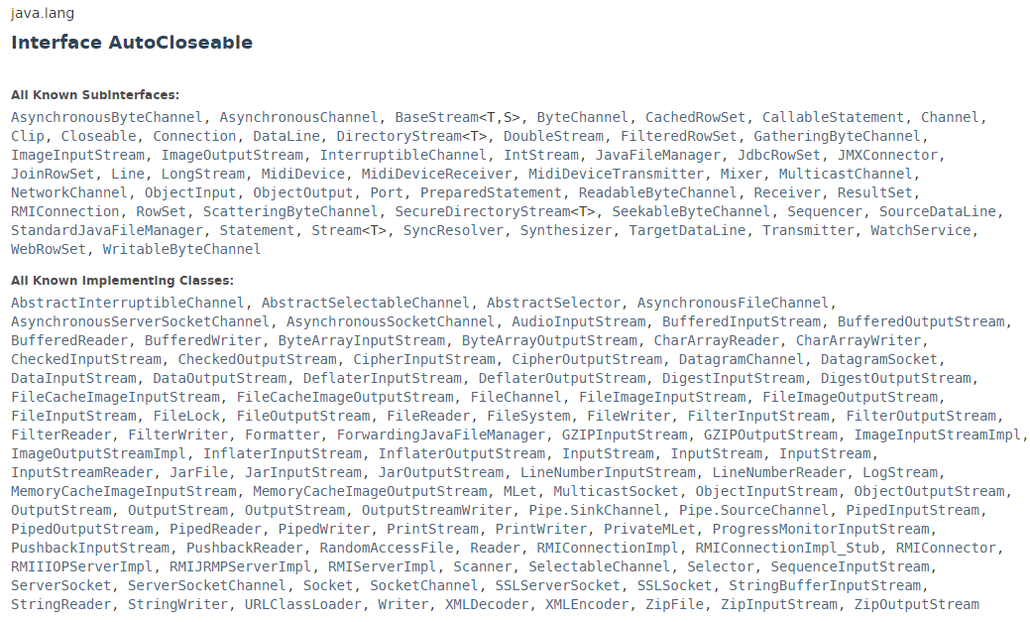
Try-with-resources

Slide 4
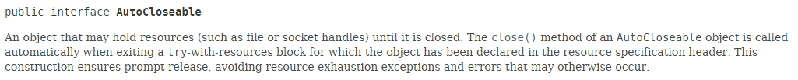
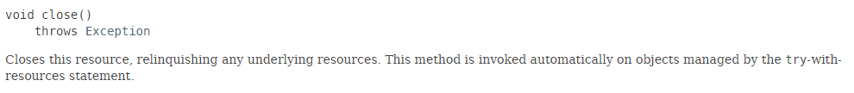
Try-with-resources

Slide 5
Try-with-resources
https://docs.oracle.com/javase/8/docs/api/index.html?java/lang/AutoCloseable.html

